Slide 1
DROWSISHIELD
A001 – ARYAN AMBRE

Slide 2
TABLE OF CONTENTS
Introduction
Objective
Literature Review
Requirements
Features
Working
Code
Output

Slide 3
INTRODUCTION
Road accidents, especially those caused by driver drowsiness, pose a significant threat to public safety. Fatigue and lack of alertness contribute to accidents, particularly during nighttime or long journeys.
One such revolutionary innovation is the Driver Drowsiness Detection (DDD) systems, which are designed to mitigate the risks associated with driving fatigue.
By warning the driver or triggering preventive measures, DDD systems play a key role in increasing overall road safety and preventing potential accidents caused by driver fatigue.
To address this critical issue, we propose an intelligent system that monitors the driver’s condition and provides timely alerts.

Slide 4
Objectives
To develop a robust hardware setup comprising an Arduino Nano microcontroller, eye blink sensor, buzzer, vibration motor, GSM module, and GPS module. Immediately notify emergency services with accurate location details.
To design and integrate feedback mechanisms utilizing the buzzer and vibration motor to promptly alert the driver upon detection of drowsiness.
To develop a user-friendly device allowing the driver to manually deactivate the alert system using a switch button when necessary.
To integrate the GSM module to enable automatic transmission of SMS alerts to predefined emergency contacts in the event of an accident and to incorporate the GPS module to provide real-time location data, facilitating precise localization of the vehicle during emergency situations.

Slide 5
Literature REVIEW
Sr.No | Title | Author | Publication | Year | Summary | Advantages | Disadvantages | Link
1 | Driver Drowsiness Detection Based on Eye Blink | Indrachapa Buwaneka Bandara | Buckinghamshire New University, Brunel University | Mar-09 | Develop a prototype drowsiness detection system to detect driver drowsiness to warn the driver before driving is impaired. Head Mounted with video camera with low intensity to illuminate the sclera region of the eye and capture changes of sclera area relating to identify blink and frequency. | Compact device and can capture the video of the person easily. | Does not include out of bound measure | https://core.ac.uk/download/pdf/288218625.pdf
2 | IoT-Based Non-Intrusive Automated Driver Drowsiness Monitoring Framework for Logistics and Public Transport Applications to Enhance Road Safety | M. ADIL KHAN, TAHIR NAWAZ , UMAR S. KHAN , (Member, IEEE), AMIR HAMZA, AND NASIR RASHID | National Centre of Robotics and Automation (NCRA), National University of Sciences and Technology | Feb-23 | This paper proposes an end-to-end non-intrusive IoT-based automated framework to monitor driver behaviors, designed specifically for logistic and public transport applications. It consists of an embedded system, edge computing and cloud computing modules, and a mobile phone application, in an attempt to provide a holistic unified solution for drowsiness detection, monitoring, as well as evaluation of drivers. Drowsiness detection is based on detecting sleeping, yawning, and distraction behaviors using an image processing-based technique. | The system has obtained a very encouraging performance for drowsiness detection in terms of achieving promising scores for Precision, Recall, F1-score, and Accuracy measures. | limitation of the proposed framework in the form of the misclassifications that have been obtained in some sample images of the dataset containing reflections caused due to spectacles worn by subjects (drivers) | https://ieeexplore.ieee.org/stamp/stamp.jsp?arnumber=10041913

Slide 6
Literature REVIEW
3 | Eye Tracking System to Detect Driver Drowsiness | T. P. Nguyen, M. T. Chew, S. Demidenko | Centre of Technology RMIT University, School of Engineering and Advanced Technology Massey University. | Apr-15 | The prototype Eye Tracking System for Drowsiness Detection includes a dashboard mounted commodity camera, simple alarm board and processor (laptop). The system performs a real-time processing of the input image stream so to compute the level of fatigue of the driver. The analysis is based on calculating a number of frames of the data stream where the driver eyes are closed. The result of the processing is sent to the alarm board, which activates an alarm signal when the drowsiness index exceeds a pre-specified parameter. | The accuracy of the eye state detection is in excess of 95% for the analyzed lighting conditions. The system provides user friendly GUI. | Cannot detect in night conditions. | https://www.researchgate.net/publication/283018835_Eye_tracking_system_to_detect_driver_drowsiness
4 | Detection of Driver Drowsiness Using Eye Blink Sensor | Apurva Mirge, Priya Sharma, Kashmira Shendge, Savita Thakre, Prof. Ajit Pagar | Department of Computer Engineering, Dr. D. Y. Patil School of Engineering, Lohegoan, Savitribai Phule Pune University | 2020 | This system is developed using various sensors like eye blink sensor, alcohol sensor, fire sensor and raspberry pi microcontroller. If the driver is found drowsy, he will be alerted by buzzing alarm. | The device prototype supports quality, low cost, flexibility and user safety | No Gps Loaction of the driver in this system. | https://ijsrset.com/IJSRSET2051043

Slide 7
requirements
Hardware
Arduino Nano: Responsible for processing data and controlling other components.
Eye Blink Sensor: Monitors the driver’s eye blinks to detect drowsiness.
Switch: Manually deactivate the alert system using a switch button when necessary.
Buzzer: Provides an audible alert to the driver.
Vibration motor: Vibrates to wake up the driver.
GSM Module: Enables communication via SMS.
GPS Module: Determines the vehicle’s location.
Software
Arduino IDE

Slide 8
FEATURES
Provides real-time data on eye behavior.
Alerts the driver when drowsiness is detected.
Can be manually turned off by the driver using a switch button.
Enables communication via SMS and sends immediate alerts to a designated contact (e.g., family member or vehicle owner) when drowsiness is detected.
Determines the precise location of the vehicle.
Prioritizes driver safety by minimizing distraction and allows the driver to manually turn off SMS and GPS alerts using the switch button when not needed.

Slide 9
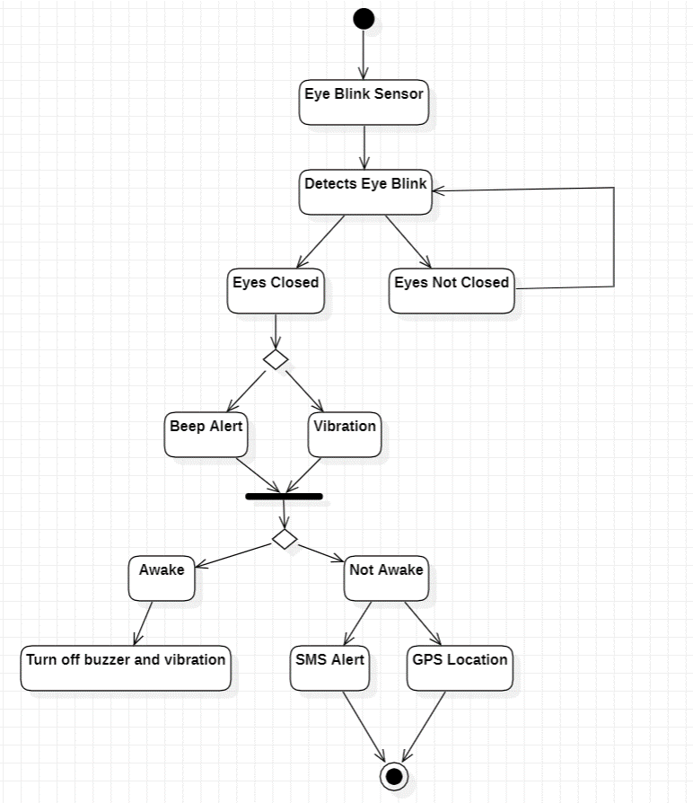
WORKING

Slide 10
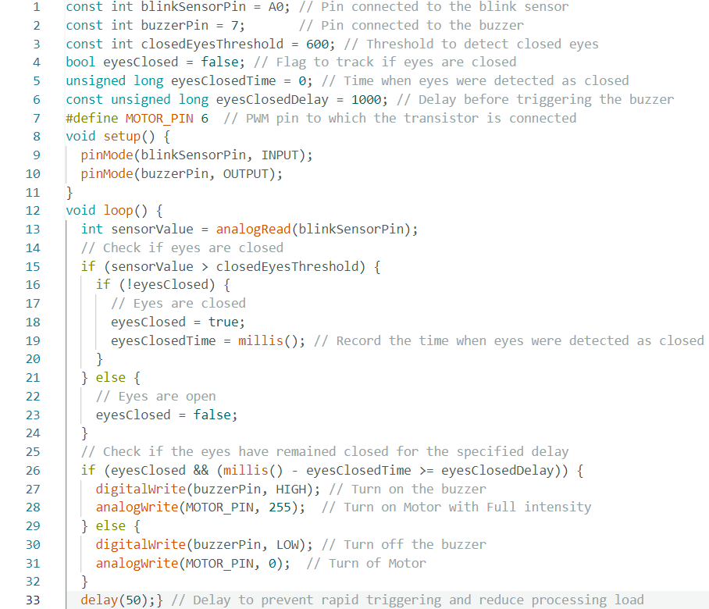
CODE

Slide 11
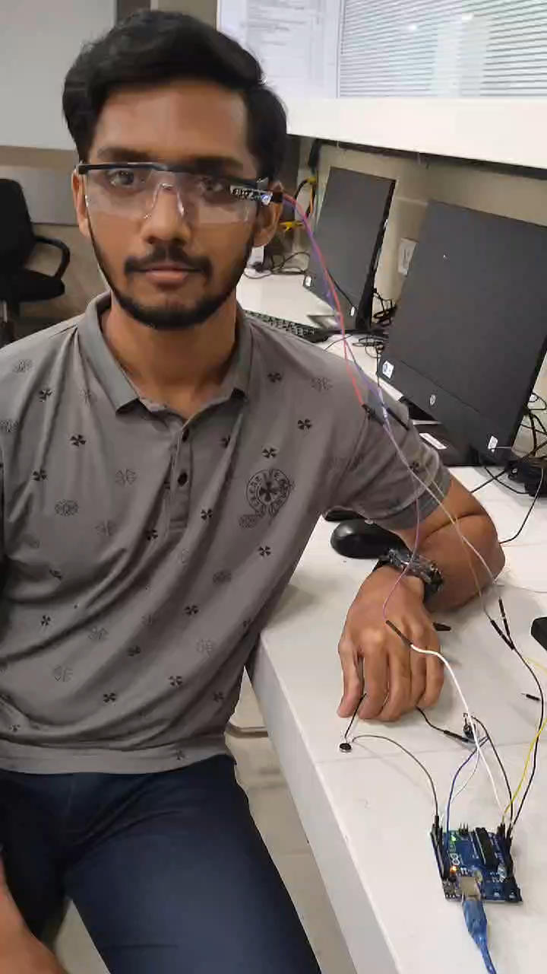
VIDEO OF WORKING

Slide 12
THANK YOU

